Slide 1

Academic Year 2024 - 25 S6 MINI PROJECT - I
First Review
PROJECT TITLE
AI-Powered Farming Guide
BIP PROJECT ID 26S6MIN410
CATERGORY INTERNAL
BATCH MEMBERS
HARI HARAN D (7376222AD140)
ABIRAMI D R (7376222AD107)
ARUNA A (7376221CD104)
DEVADHARSHINI K (7376222AL122)
GUIDE
Ms ESAKKI MADURA E
Assistant Professor - II
Department of Artificial Intelligence and Data Science

Slide 2
AIM & OBJECTIVES OF THE PROJECT
(Problem Statement)
Background should be White in all slides
Font
Cambria
Font Size & Colors
Headings – Blue – UPPERCASE – Bold ( Font Size 24)
Subheadings Maroon / Violet / Green - Sentence Case- Bold ( Font Size 24)
Black for Contents ( Font Size 20)
18-02-2025
FIRST REVIEW PRESENTATION
2

Slide 3
LITERATURE SURVEY
Journal Paper Title with Author | Works carried out (withdetails of Methods/ Materials/ Software/ Algorithms/ fabrication/ techniques/ components used) | Information gathered relevant to your project
AI Based Farmer’s Assistance Chatbot Patha Druva, International Journal for Research in Applied Science and Engineering Technology (IJRASET), 2023 | Developed a chatbot using Natural Language Processing (NLP) to assist farmers. - Provides predictions on fertilizer requirements and nutrient levels. - Uses pre-determined data sources, including The Indian Council of Agricultural Research, for accuracy | Helps farmers manage crops efficiently. - Provides real-time assistance for agricultural queries. - Enhances agricultural productivity using AI.
"Farmer’s Assistant using AI Voice Bot" A. B. Author, C. D. Researcher, E. F. Scientist, International Journal of Advanced Research in Science, Communication, and Technology (IJARSCT), April 2023 | - Developed an AI-based chatbot to assist farmers in multiple languages (English, Hindi, Marathi). - Utilized Natural Language Processing (NLP) to process and respond to user queries. - Designed to improve agricultural productivity by providing information on crop management, fertilizers, and best practices. - Integrated with AI voice recognition for a user-friendly experience. | Enables farmers to get real-time guidance in multiple languages. - Enhances accessibility and ease of use with voice-based interactions. - Supports better decision-making in crop selection, fertilizers, and irrigation.

Slide 4
LITERATURE SURVEY
Journal Paper Title with Author | Works carried out (withdetails of Methods/ Materials/ Software/ Algorithms/ fabrication/ techniques/ components used) | Information gathered relevant to your project
"Farmer-Bot: An Interactive Bot for Farmers" Narayana Darapaneni, Rajiv Tiwari, Anwesh Paduri, Suman Saurav, Rohit Chaoji, Sohil, arXiv, April 2022 | Developed an AI-based chatbot specifically designed for farmers. - Utilized Natural Language Processing (NLP) to provide interactive support. - Implemented machine learning techniques to enhance recommendations. - Designed to offer agricultural guidance, weather updates, and farming tips. | - Helps farmers make informed decisions using AI. - Provides real-time information on farming techniques, weather conditions, and crop recommendations. - Enhances agricultural efficiency through automated assistance.
Chatbot in Python By Sneha S, Sneha M, Shashank S, Soundarya C, Venkatesh R IRJET (Volume 06, Issue 11, Nov 2019) | Used AIML (Artificial Intelligence Markup Language) for pattern-based query responses. Latent Semantic Analysis (LSA) to find word similarities and generate responses. - Implemented using Python and Flask Web Framework. - Integrated APIs like Wikipedia, Weather Forecast, News, and Government Services for real-time data. | Demonstrates chatbot implementation using AIML and LSA.Explores how chatbots handle queries efficiently.Provides insights into integrating external APIs to improve chatbot intelligence.

Slide 5
SCOPE OF THE PROJECT
Background should be White in all slides
Font
Cambria
Font Size & Colors
Headings – Blue – UPPERCASE – Bold ( Font Size 24)
Subheadings Maroon / Violet / Green - Sentence Case- Bold ( Font Size 24)
Black for Contents ( Font Size 20)
FIRST REVIEW PRESENTATION

Slide 6
NEED FOR THE CURRENT STUDY
Background should be White in all slides
Font
Cambria
Font Size & Colors
Headings – Blue – UPPERCASE – Bold ( Font Size 24)
Subheadings Maroon / Violet / Green - Sentence Case- Bold ( Font Size 24)
Black for Contents ( Font Size 20)
FIRST REVIEW PRESENTATION

Slide 7
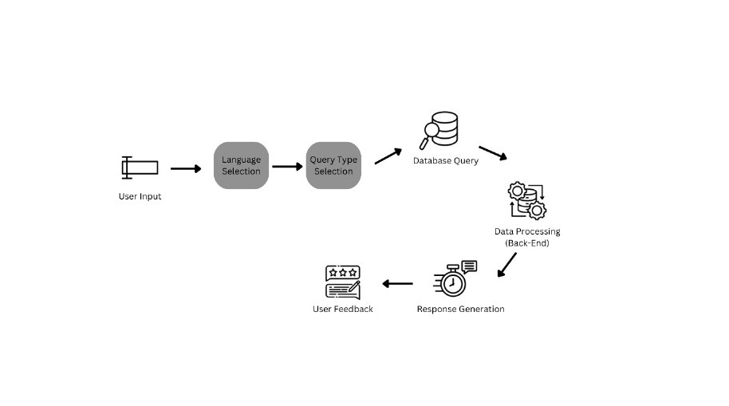
PROPOSED METHODOLOGY ( Flow Chart)

Slide 8
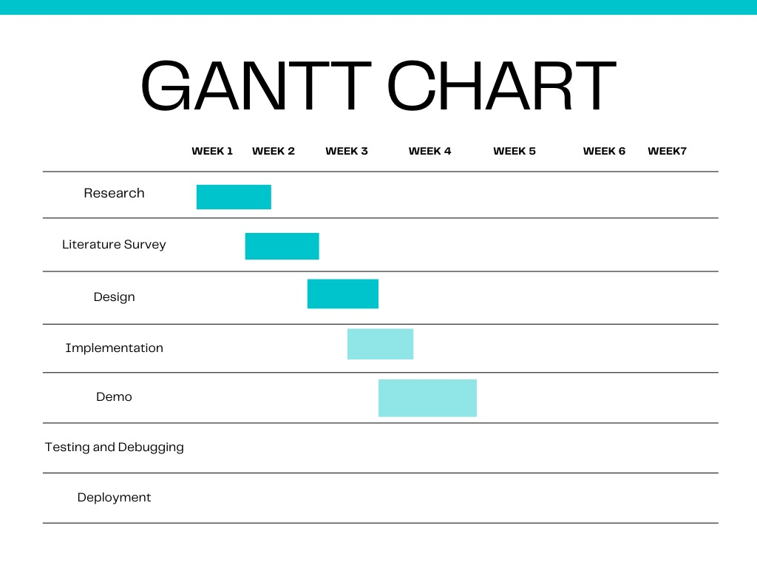
PROPOSED METHODOLOGY ( Gantt Chart)

Slide 9
CHOICE OF COMPONENTS / MODULES / METHODS/TECHNIQUES EQUIPMENT USED FOR PROJECT DEVELOPMENT
COMPONENTS & MODULES:
User Interface (Frontend) – Website for farmers to interact with the chatbot.
Chatbot Engine (Backend) – AI-powered chatbot built using Python.
Database Module – MongoDB for storing agricultural queries and responses.
API Integration Module – Fetches real-time weather, market prices, and agricultural updates.
Speech Processing Module – Converts text to speech using pyttsx3 for voice responses.
METHODS & TECHNIQUES:
Natural Language Processing (NLP): Helps chatbot understand user queries.
Machine Learning (Optional): Can improve chatbot responses over time.
Web Development: React.js for frontend and Flask/Django for backend.
Data Storage & Retrieval: Efficient handling of user queries with MongoDB.
FIRST REVIEW PRESENTATION9

Slide 10
DESIGN(S) (HARDWARE / SOFTWARE ARCHITECTURE)
SYSTEM ARCHITECTURE OVERVIEW :
User Interface (Frontend - React.js)
Farmers interact with the chatbot through a React.js-based web application.
Provides a simple, user-friendly interface for text and voice-based queries.
Backend Processing (Flask/Django - Python)
Manages chatbot logic, processes user queries, and fetches responses.
Implements Natural Language Processing (NLP) to understand and respond effectively.
Database Management (MongoDB)
Stores predefined agricultural FAQs, chatbot responses, and user interactions.
Allows efficient data retrieval for real-time assistance.
API Integration Module
Fetches real-time weather updates, market prices, and agriculture news from external APIs.
Ensures farmers receive up-to-date information.
Speech Processing Module
Uses pyttsx3 (Text-to-Speech) to convert responses into voice output.
Helps farmers who prefer audio-based assistance.

Slide 11
INDIVIDUAL CONTRIBUTIONS TO THE WORK
Batch Member 1 : ( Reg No… & Name )
.....
….
…
….
….

Slide 12
INDIVIDUAL CONTRIBUTIONS TO THE WORK
Batch Member 2 : (Reg No.& Name )
.....
….
…
….
….

Slide 13
INDIVIDUAL CONTRIBUTIONS TO THE WORK
Batch Member 3 : (Reg No.& Name )
.....
….
…
….
….

Slide 14
INDIVIDUAL CONTRIBUTIONS TO THE WORK
Batch Member 4 : (Reg No.& Name )
.....
….
…
….
….

Slide 15
PENDING WORKS AND PLAN FOR COMPLETION
.....
….
…
….
….

Slide 16
PLAN FOR PUBLICATIONS
Journal / Conference Identified for Submission
Tentative Dates for Submission / Presentation / Acceptance

Slide 17
Status on Partial Completion and Submission of Project Report
List of Documents to be Submitted
SL.No | List of Documents | Status ( Provide the drive link of prepared document)
1 | Cover Page & Title Page (Both are in same format)
2 | Bonafide Certificate
3 | Declaration
4 | Acknowledgement
5 | Chapter I – Introduction
6 | Chapter 2 – Literature Survey

Slide 18
Any Other Relevant Details

Slide 19
Any Other Relevant Details

Slide 20
REFERENCES
( Journal Papers/ Books / Website in IEEE Format )
Journal
[1]. A. Vaskuri, H. Baumgartner, P. Kärhä, G. Andor, and E. Ikonen, "Modeling the spectral shape of
InGaAlP-based red light-emitting diodes," Journal of Applied Physics, vol. 118, no. 20, pp. 203103-1–203103-7.
[2]…………………….……….
Books
[1]. A. J. Stewart, A Vulnerable System: The History of Information Security in the Computer Age, Ithaca, NY, USA: Cornell Univ. Press, 2021.
[2]…………………………………..
Patent
[1]. M. A. Genius, “Brain Grow-a-Matic 4 Kids,” US Patent 3 400 126, Mar. 21, 2019.
Website
[1]. D. Holland, "Finding the Building Blocks of Wood." unimelb.edu.au. https://pursuit.unimelb.edu.au/articles/finding-the-building-blocks-of wood?utm_source=linkedin.com&utm_medium=social&utm_content=story.

